Slide 1
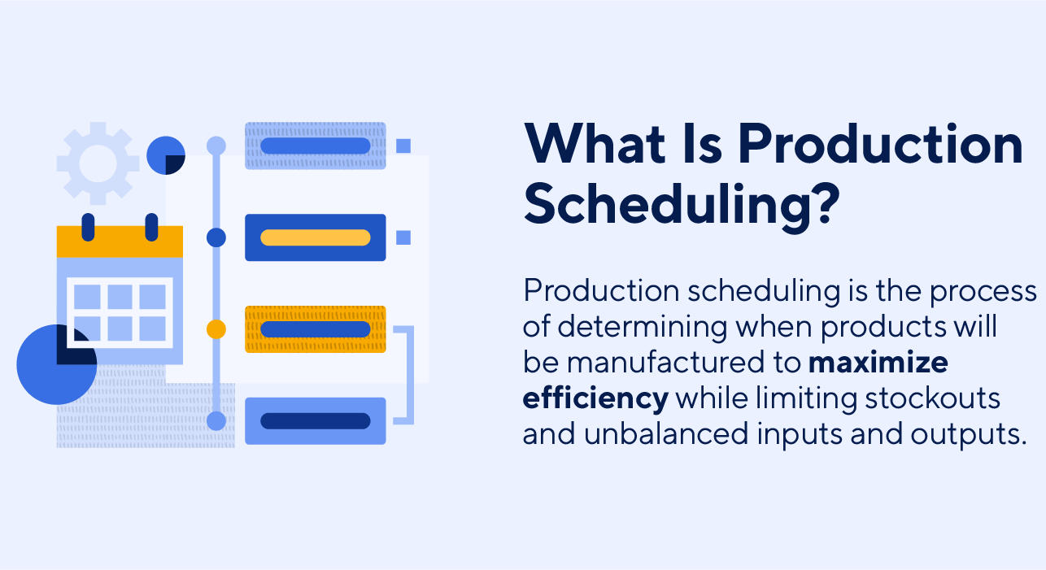
1. Production Scheduling in Hybrid Flow Shop
The Importance of Production Scheduling
reduce bottlenecks and downtime
maintain stock levels
record and maintain working hours
optimize workstations and equipment usage
allocate resources efficiently and optimally
increase the quality of products
help keep customer orders fulfilled on time
……..
Source from: https://www.smartsheet.com/content/production-scheduling
Notes:
Data in different formats, such as numerical data, graphical data, and textual data
With effective processing and analysis, they can provide valuable information to perform a great many significant activities such as decision-making, product design, machine failure detection and others
Each organization has an enormous number of maintenance reports/logs or maintenance work orders that contains maintenance time, equipment or machine, maintenance process, etc., which can help technicians finish a variety of tasks
The considerable quantity of textual information provides new opportunities to explore industrial maintenance approaches

Slide 2
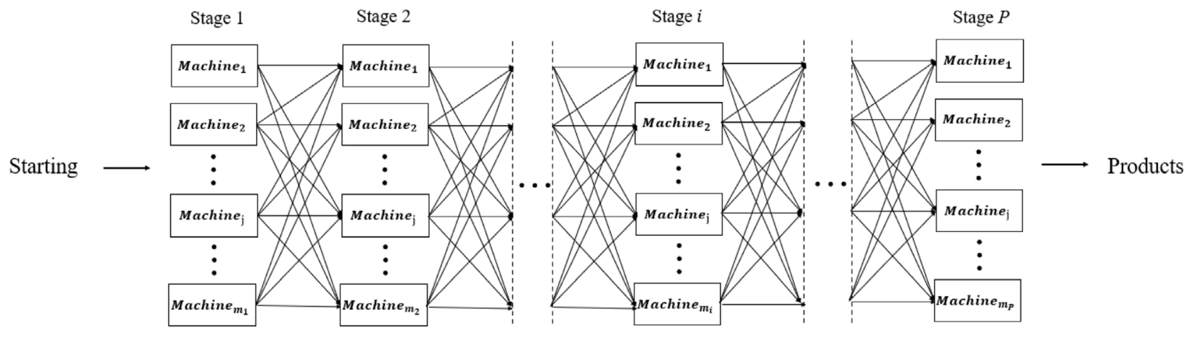
1. Production Scheduling in Hybrid Flow Shop
Some special settings in hybrid flow shops (HFS)
the number of processing stages is at least 2
each stage has at least one machine in parallel and at least one stage have more than one machines
all the jobs follow the same workflow (from stage 1 to stage P)
processing time of the same job differs in different stages
Shen, Y., Zhang, X., & Shi, L. (2022). Joint optimization of production and maintenance for a serial–parallel hybrid two-stage production system. Reliability Engineering & System Safety, 226, 108600.
Notes:
Data in different formats, such as numerical data, graphical data, and textual data
With effective processing and analysis, they can provide valuable information to perform a great many significant activities such as decision-making, product design, machine failure detection and others
Each organization has an enormous number of maintenance reports/logs or maintenance work orders that contains maintenance time, equipment or machine, maintenance process, etc., which can help technicians finish a variety of tasks
The considerable quantity of textual information provides new opportunities to explore industrial maintenance approaches

Slide 3



2. Current Studies in Hybrid Flow Shop Production Scheduling
Real world scenarios with hybrid flow shops (HFS)
electronics manufacturing
paper & textile industries
production of concrete (precast concrete, modular production)
Classification of hybrid flow shops (HFS)
$$α$$
$$β$$
$$γ$$
Layout of the system
Available settings
Objective
Ruiz, R., & Vázquez-Rodríguez, J. A. (2010). The hybrid flow shop scheduling problem. European journal of operational research, 205(1), 1-18. (Cited 990)
Notes:
Data in different formats, such as numerical data, graphical data, and textual data
With effective processing and analysis, they can provide valuable information to perform a great many significant activities such as decision-making, product design, machine failure detection and others
Each organization has an enormous number of maintenance reports/logs or maintenance work orders that contains maintenance time, equipment or machine, maintenance process, etc., which can help technicians finish a variety of tasks
The considerable quantity of textual information provides new opportunities to explore industrial maintenance approaches

Slide 4
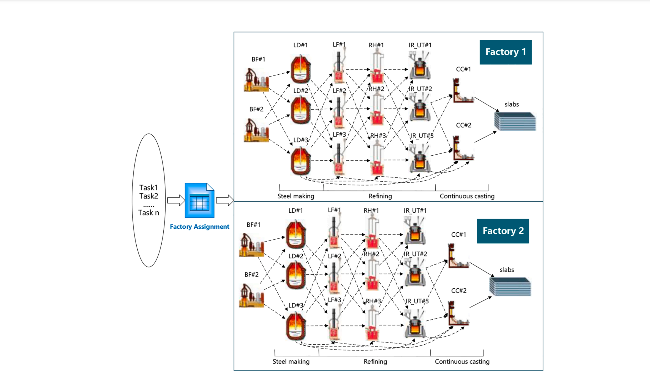
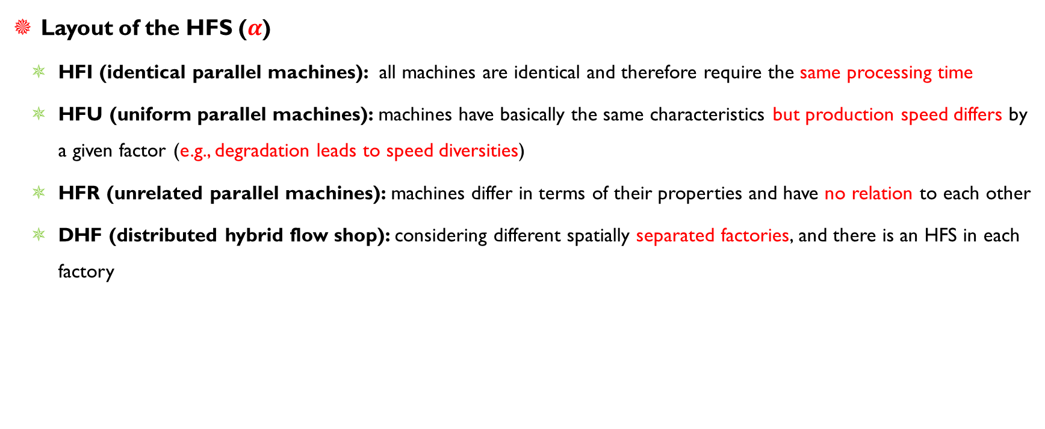
2. Current Studies in Hybrid Flow Shop Production Scheduling
Layout of the HFS ($α$)
HFI (identical parallel machines): all machines are identical and therefore require the same processing time
HFU (uniform parallel machines): machines have basically the same characteristics but production speed differs by a given factor (e.g., degradation leads to speed diversities)
HFR (unrelated parallel machines): machines differ in terms of their properties and have no relation to each other
DHF (distributed hybrid flow shop): considering different spatially separated factories, and there is an HFS in each factory
Example of DHF
Graham, R. L., Lawler, E. L., Lenstra, J. K., & Kan, A. R. (1979). Optimization and approximation in deterministic sequencing and scheduling: a survey. In Annals of discrete mathematics (Vol. 5, pp. 287-326). Elsevier. (Cited 8910)
Notes:
Data in different formats, such as numerical data, graphical data, and textual data
With effective processing and analysis, they can provide valuable information to perform a great many significant activities such as decision-making, product design, machine failure detection and others
Each organization has an enormous number of maintenance reports/logs or maintenance work orders that contains maintenance time, equipment or machine, maintenance process, etc., which can help technicians finish a variety of tasks
The considerable quantity of textual information provides new opportunities to explore industrial maintenance approaches

Slide 5
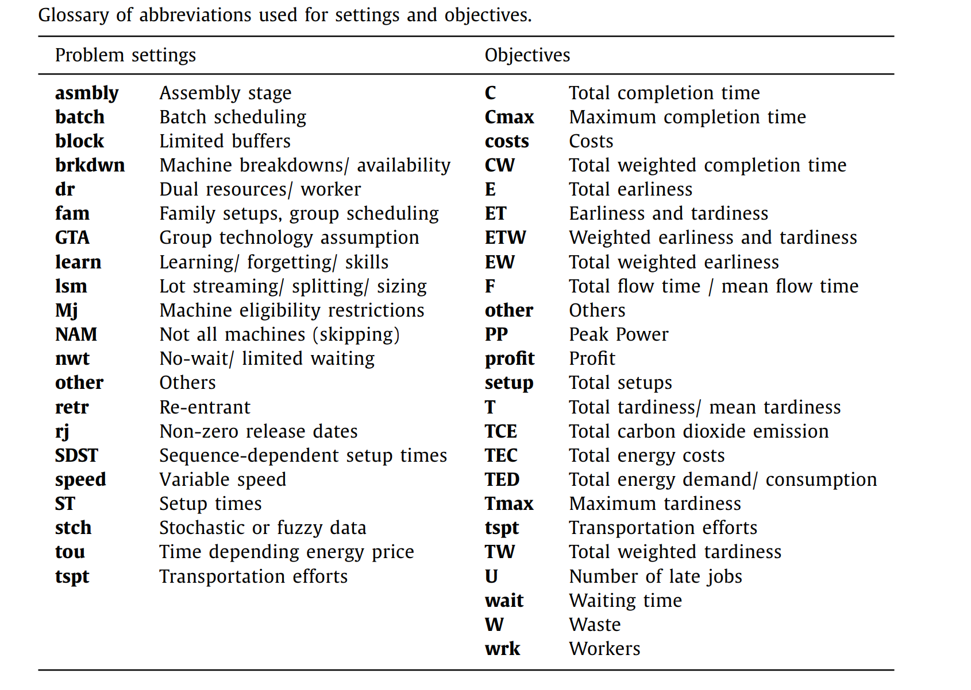

2. Current Studies in Hybrid Flow Shop Production Scheduling
Available settings of the HFS ($β$)
setup times
variable speeds
stochastic influences
possibility of rejecting certain jobs
Objectives ($γ$)
completion times/makespan (77%)
punctuality
environmental sustainability
monetary
others
Neufeld, J. S., Schulz, S., & Buscher, U. (2023). A systematic review of multi-objective hybrid flow shop scheduling. European Journal of Operational Research, 309(1), 1-23.
Notes:
Data in different formats, such as numerical data, graphical data, and textual data
With effective processing and analysis, they can provide valuable information to perform a great many significant activities such as decision-making, product design, machine failure detection and others
Each organization has an enormous number of maintenance reports/logs or maintenance work orders that contains maintenance time, equipment or machine, maintenance process, etc., which can help technicians finish a variety of tasks
The considerable quantity of textual information provides new opportunities to explore industrial maintenance approaches

Slide 6
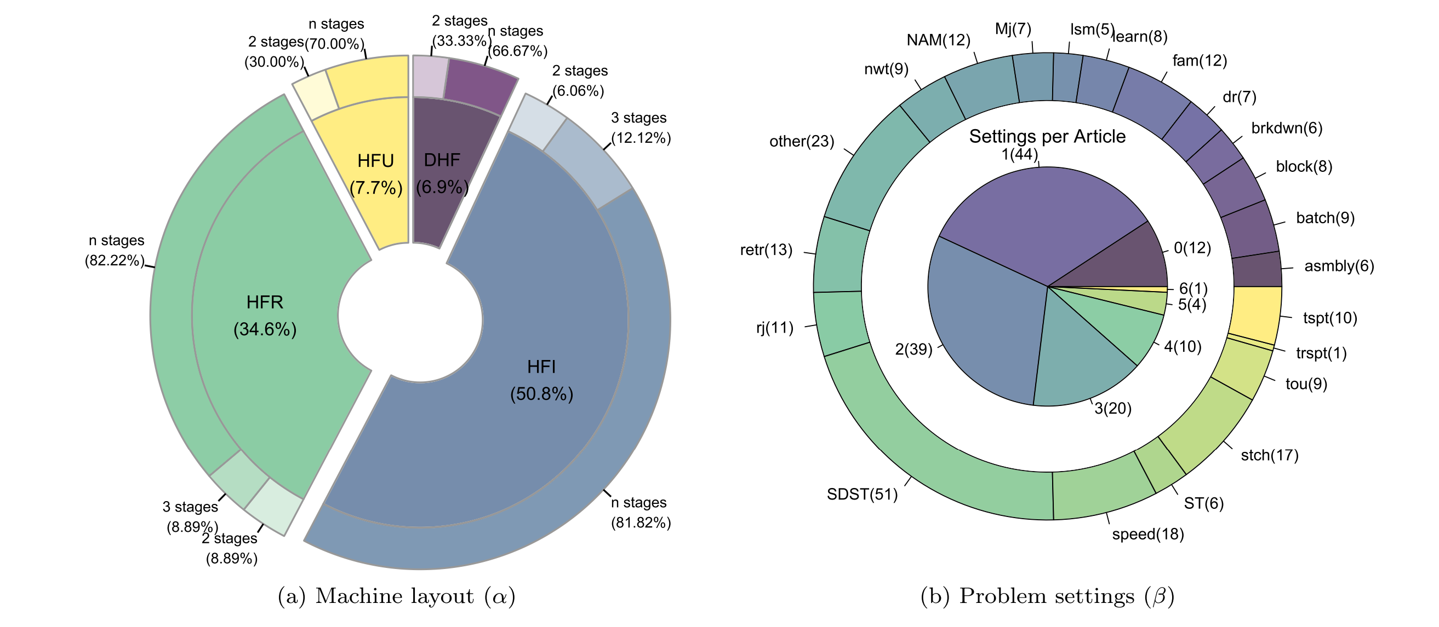
2. Current Studies in Hybrid Flow Shop Production Scheduling
Some statistics for hybrid flow shop scheduling
Neufeld, J. S., Schulz, S., & Buscher, U. (2023). A systematic review of multi-objective hybrid flow shop scheduling. European Journal of Operational Research, 309(1), 1-23.
Notes:
Data in different formats, such as numerical data, graphical data, and textual data
With effective processing and analysis, they can provide valuable information to perform a great many significant activities such as decision-making, product design, machine failure detection and others
Each organization has an enormous number of maintenance reports/logs or maintenance work orders that contains maintenance time, equipment or machine, maintenance process, etc., which can help technicians finish a variety of tasks
The considerable quantity of textual information provides new opportunities to explore industrial maintenance approaches

Slide 7
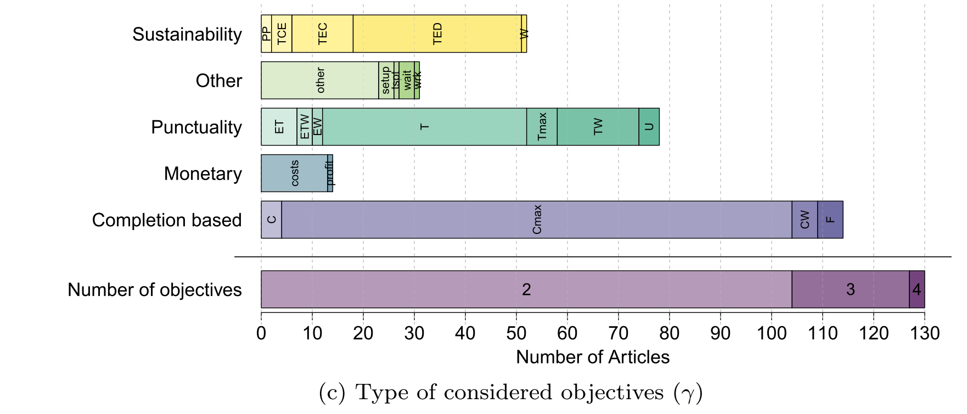
2. Current Studies in Hybrid Flow Shop Production Scheduling
Some statistics for hybrid flow shop scheduling
Neufeld, J. S., Schulz, S., & Buscher, U. (2023). A systematic review of multi-objective hybrid flow shop scheduling. European Journal of Operational Research, 309(1), 1-23.
Notes:
Data in different formats, such as numerical data, graphical data, and textual data
With effective processing and analysis, they can provide valuable information to perform a great many significant activities such as decision-making, product design, machine failure detection and others
Each organization has an enormous number of maintenance reports/logs or maintenance work orders that contains maintenance time, equipment or machine, maintenance process, etc., which can help technicians finish a variety of tasks
The considerable quantity of textual information provides new opportunities to explore industrial maintenance approaches

Slide 8
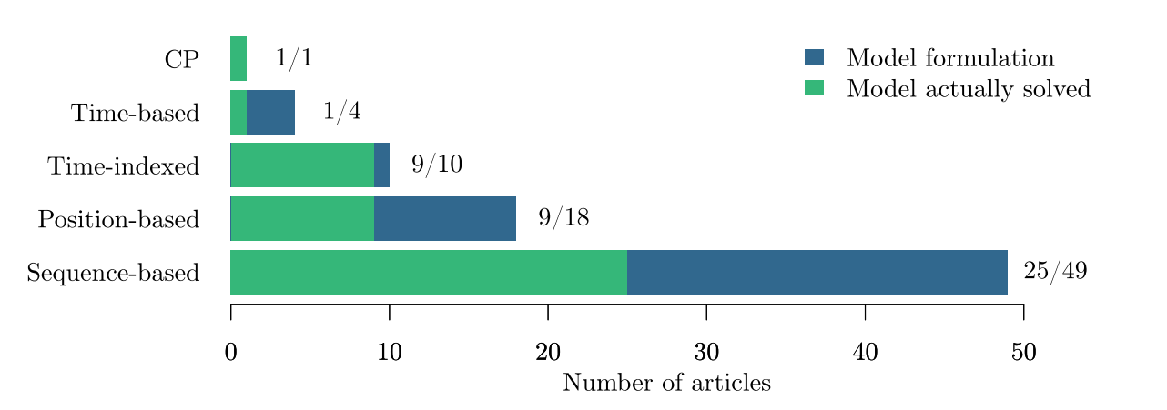
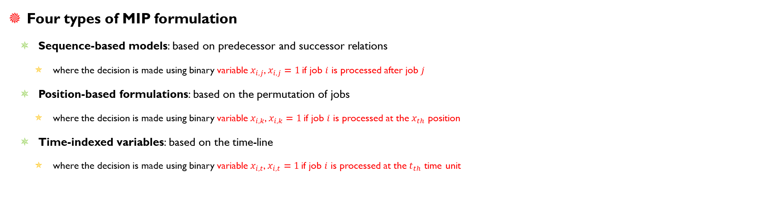
3. Model Formulations and Solutions
Four types of MIP formulation
Sequence-based models: based on predecessor and successor relations
where the decision is made using binary variable $x_{i,j}$, $x_{i,j}=1$if job $i$ is processed after job $j$
Position-based formulations: based on the permutation of jobs
where the decision is made using binary variable $x_{i,k}$, $x_{i,k}=1$if job $i$ is processed at the $x_{th}$ position
Time-indexed variables: based on the time-line
where the decision is made using binary variable $x_{i,t}$, $x_{i,t}=1$if job $i$ is processed at the $t_{th}$ time unit
Less considered
Complexity increase
Neufeld, J. S., Schulz, S., & Buscher, U. (2023). A systematic review of multi-objective hybrid flow shop scheduling. European Journal of Operational Research, 309(1), 1-23.

Slide 9
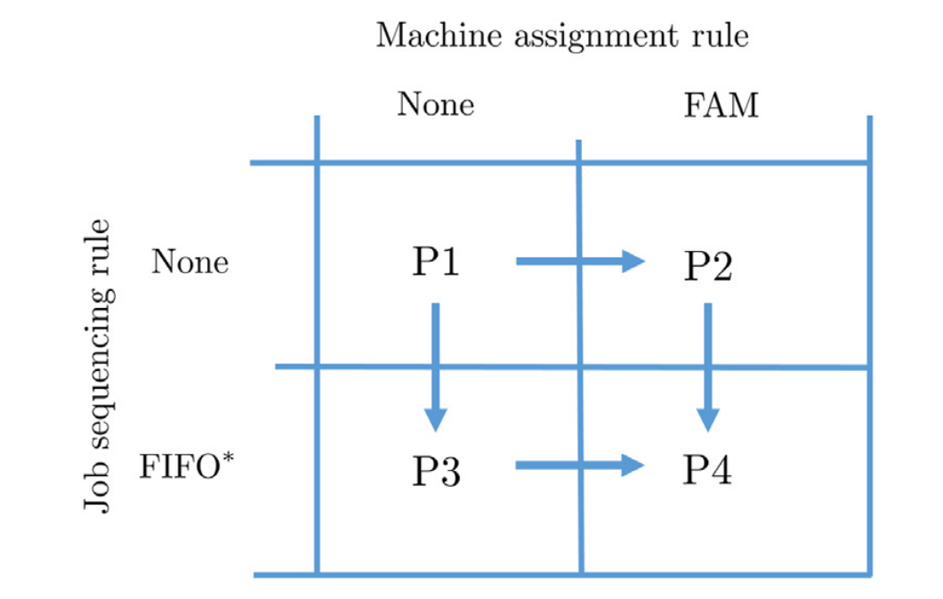
3. Model Formulations and Solutions
Solution representations
The choice of a solution representation and, thereby, the encoding and decoding of a solution is critical for the performance of a metaheuristic algorithm
Four solution representations methods
P1: job sequences and machine assignments are defined for each stage explicitly
P2: all job sequences are defined for each stage individually but the machine assignment follows a given rule
P3: machine assignment is defined for each stage, while the job sequence is encoded only for the first stage
P4: only the job sequence in the first stage is encoded.
Fernandez-Viagas, V., Perez-Gonzalez, P., & Framinan, J. M. (2019). Efficiency of the solution representations for the hybrid flow shop scheduling problem with makespan objective. Computers & Operations Research, 109, 77-88.

Slide 10
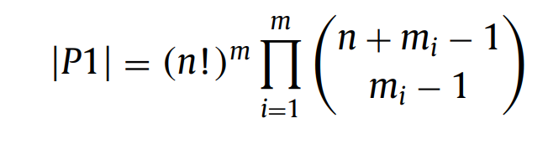
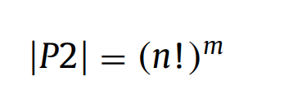
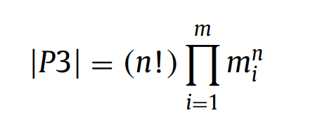
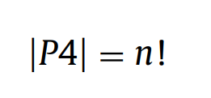
3. Model Formulations and Solutions
Complexity of the four solution representations methods
P1
P2
P4
P3
Completeness or Efficiency ?
Fernandez-Viagas, V., Perez-Gonzalez, P., & Framinan, J. M. (2019). Efficiency of the solution representations for the hybrid flow shop scheduling problem with makespan objective. Computers & Operations Research, 109, 77-88.

Slide 11
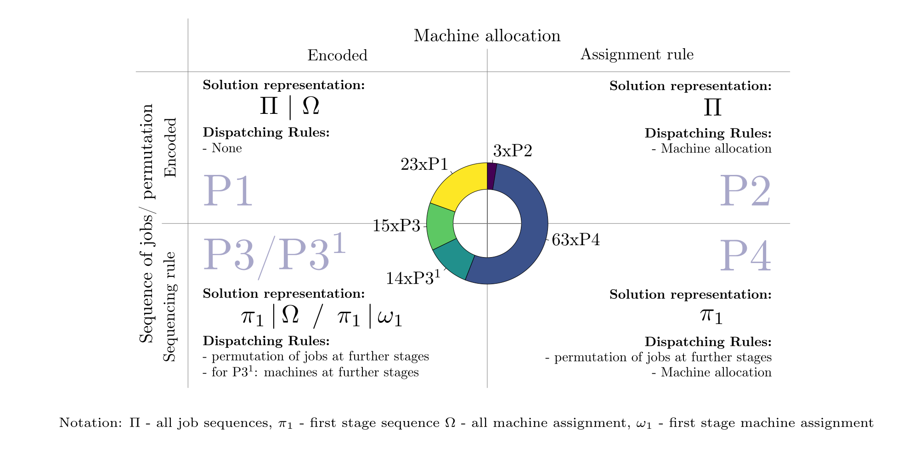
3. Model Formulations and Solutions
Complexity of the four solution representations methods
Fernandez-Viagas, V., Perez-Gonzalez, P., & Framinan, J. M. (2019). Efficiency of the solution representations for the hybrid flow shop scheduling problem with makespan objective. Computers & Operations Research, 109, 77-88.

Slide 12
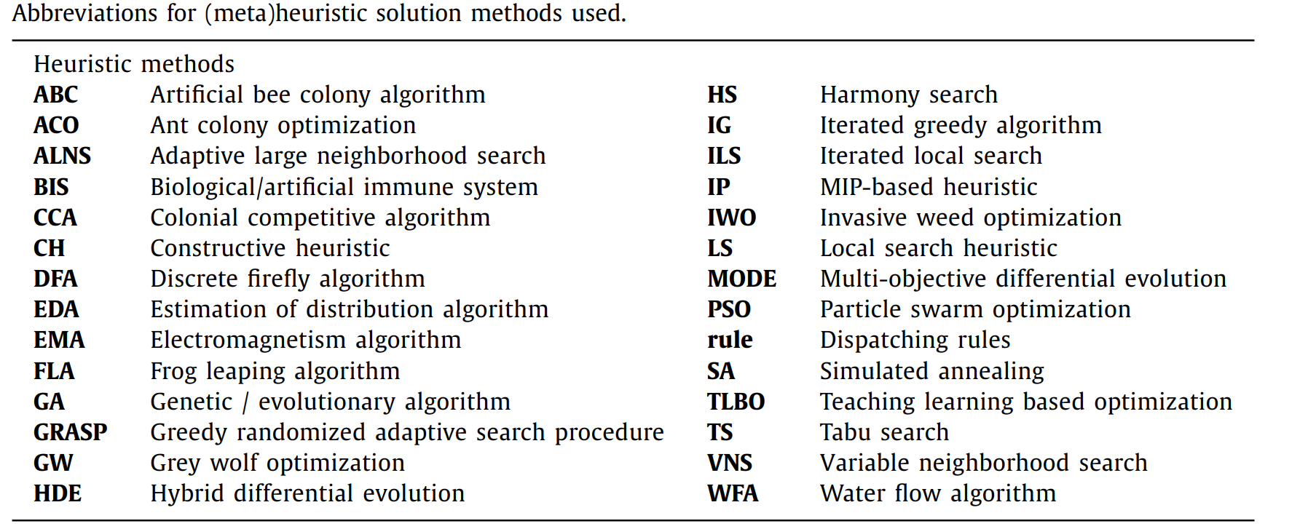
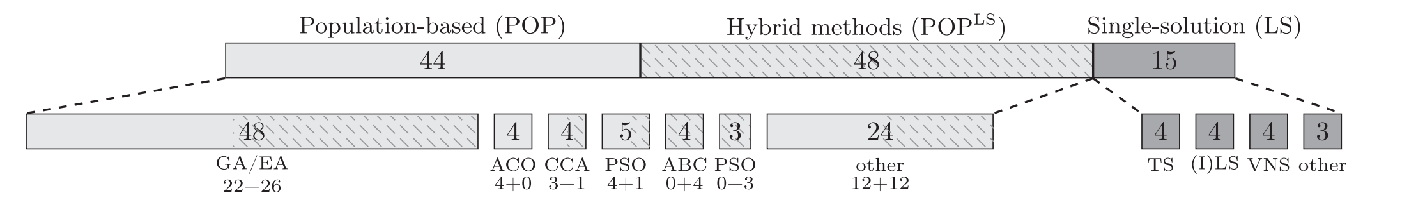
3. Model Formulations and Solutions
Solutions
Exact for small-scale problems
Metaheuristics for general problems
Fernandez-Viagas, V., Perez-Gonzalez, P., & Framinan, J. M. (2019). Efficiency of the solution representations for the hybrid flow shop scheduling problem with makespan objective. Computers & Operations Research, 109, 77-88.

Slide 13
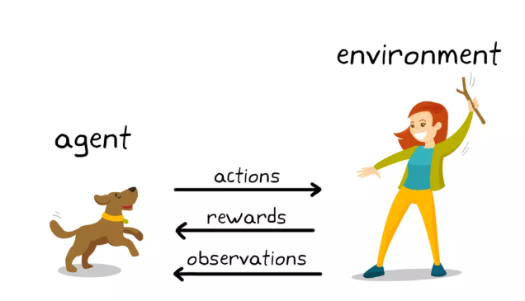
4. Reinforcement Learning for HFS Production Scheduling
Reinforcement Learning
Reinforcement Learning (RL) is a branch of machine learning focused on making decisions to maximize cumulative rewards
RL has been used for production scheduling as the potential for dynamic scheduling decision making
RL’s component
Action space
State space
Reward function
Transition function
Classification for RL
Single agent RL (e.g., DQN, DDQN, PPO)
Multi-agent RL (e.g., QMIX, VDN, MAPPO, or HAPPO)

Slide 14
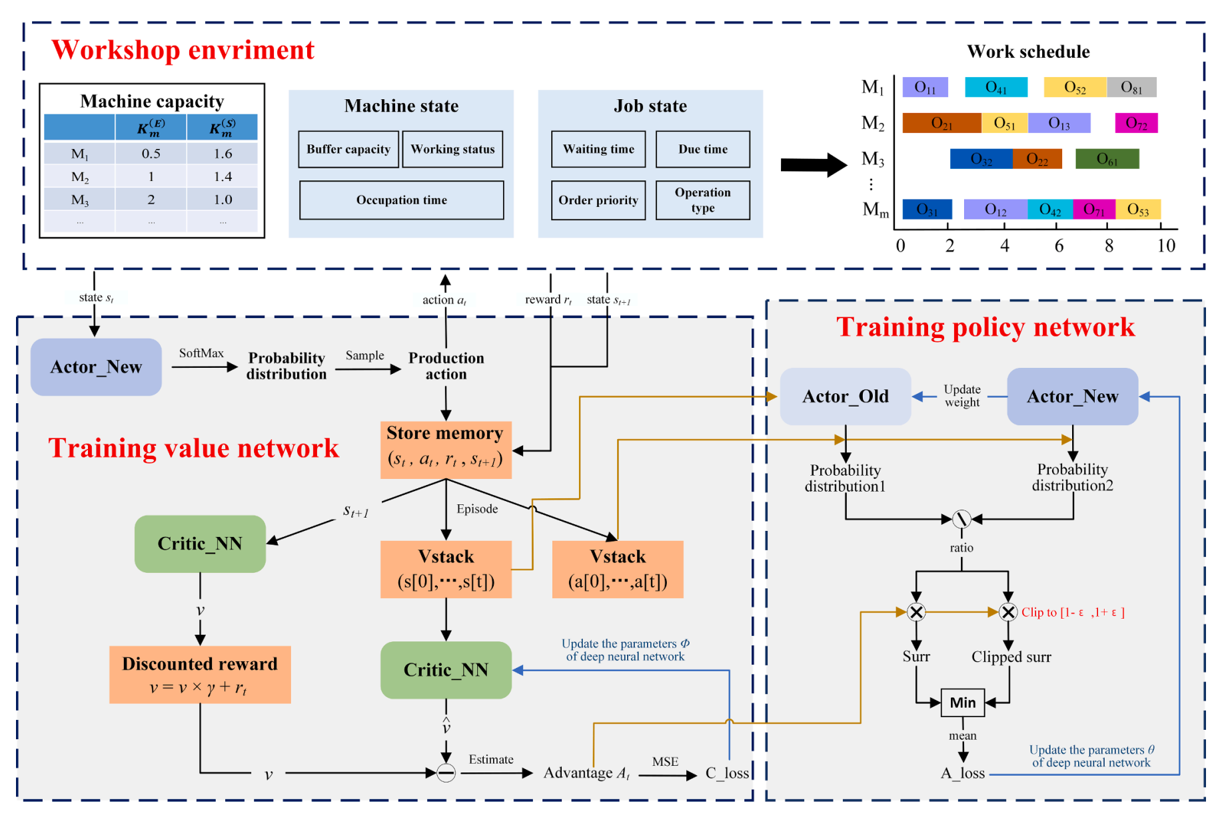
4. Reinforcement Learning for HFS Production Scheduling
Some cases
Single RL
Data-drive solution
Pros
Real-time scheduling
Self-learning
Cons
Dimension curse of the action and state space
Output mask
Zhang, Y., Zhu, H., Tang, D., Zhou, T., & Gui, Y. (2022). Dynamic job shop scheduling based on deep reinforcement learning for multi-agent manufacturing systems. Robotics and Computer-Integrated Manufacturing, 78, 102412.

Slide 15
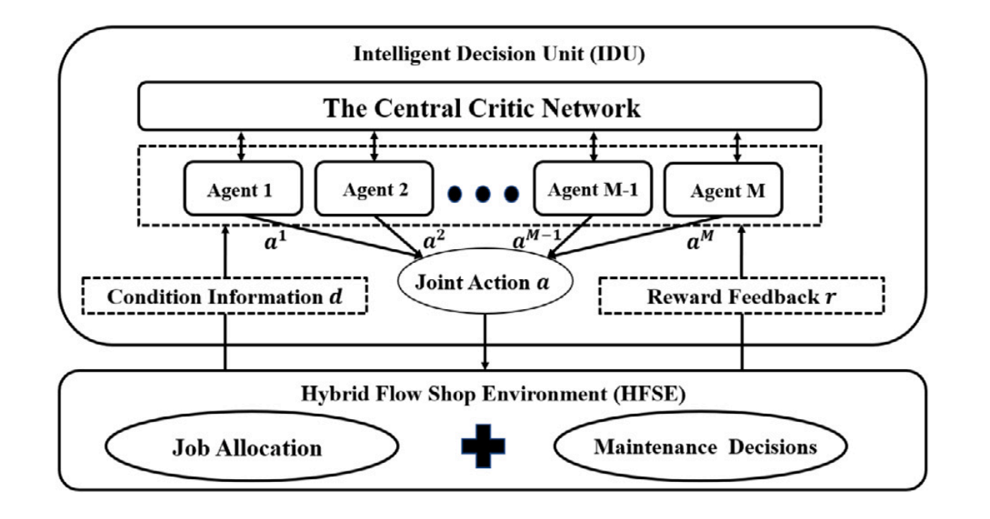
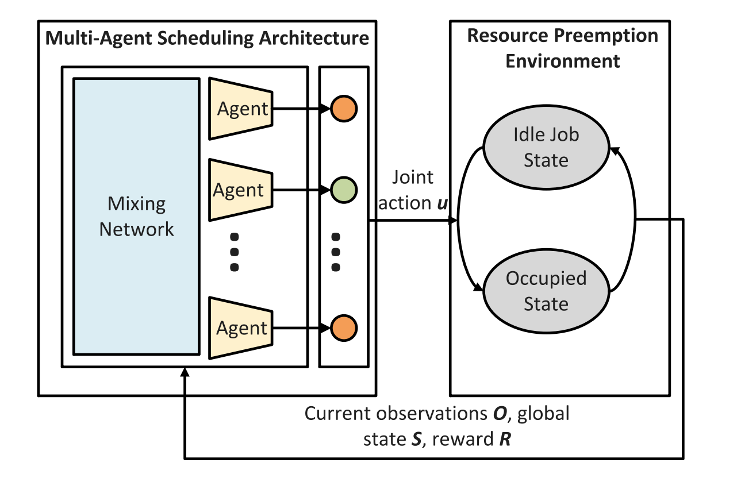
4. Reinforcement Learning for HFS Production Scheduling
Some cases
Multi-agent RL
Agents can be machines or jobs
Pros
Reduce the impact of dimensional curse
Large-scale problems
Multi-functional
Cons
Additional functional modules to learn inter-agent cooperation
Poor mobility, compatible from top to bottom
Wang, X., Zhang, L., Lin, T., Zhao, C., Wang, K., & Chen, Z. (2022). Solving job scheduling problems in a resource preemption environment with multi-agent reinforcement learning. Robotics and Computer-Integrated Manufacturing, 77, 102324.

Slide 16
5. Project 2 – Case Study
Hybrid flow shop scheduling in a precast production system
Aim: Develop production schedules for hybrid flow shops in precast concrete manufacturing by leveraging state-of-the-art algorithms
Objectives:
Master the modeling techniques for the precast hybrid flow shop (Problem description)
Attain expertise in utilizing at least one major optimization solver, e.g., Gurobi or CPLEX (Benchmarks)
Design and implement a novel meta-heuristic or reinforcement learning algorithm to enhance solution efficiency (Methodology)
Deliverables: A project report
Requirements: Introduction, literature review, methodology, and experiments with detailed analysis
Resources:
The paradigm of problem description
Commercial solver usage documentation and tutorials:
https://www.gurobi.com/documentation/current/refman/py_python_api_overview.html
https://ibmdecisionoptimization.github.io/tutorials/html/Linear_Programming.html
Basic code for meta-heuristic and RL algorithms: https://github.com/CI3LAB/CIVIL-6059-Mini-projects-Resources

Slide 17
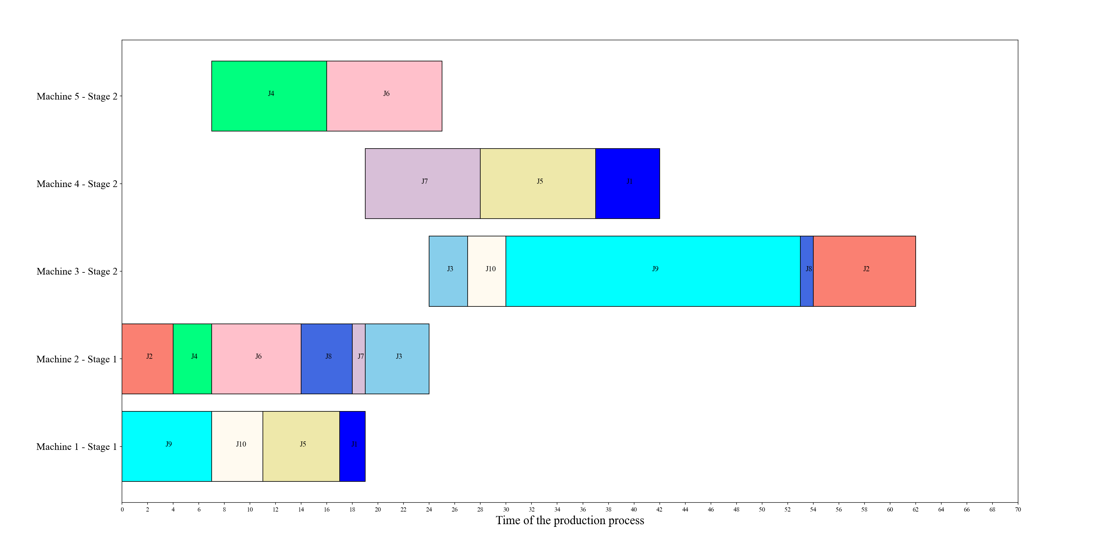
5. Case Study – Solution
Validation – Another algorithm that can deal with the larger problem
Gantt chart – the final schedule
Small-scale problem

Slide 18
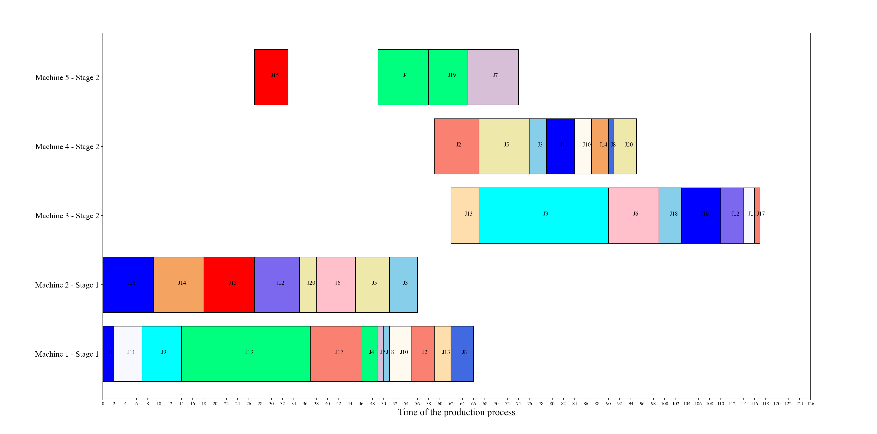
5. Case Study – Solution
Validation – Another algorithm that can deal with the larger problem
Gantt chart – the final schedule
Medium-scale problem

Slide 19
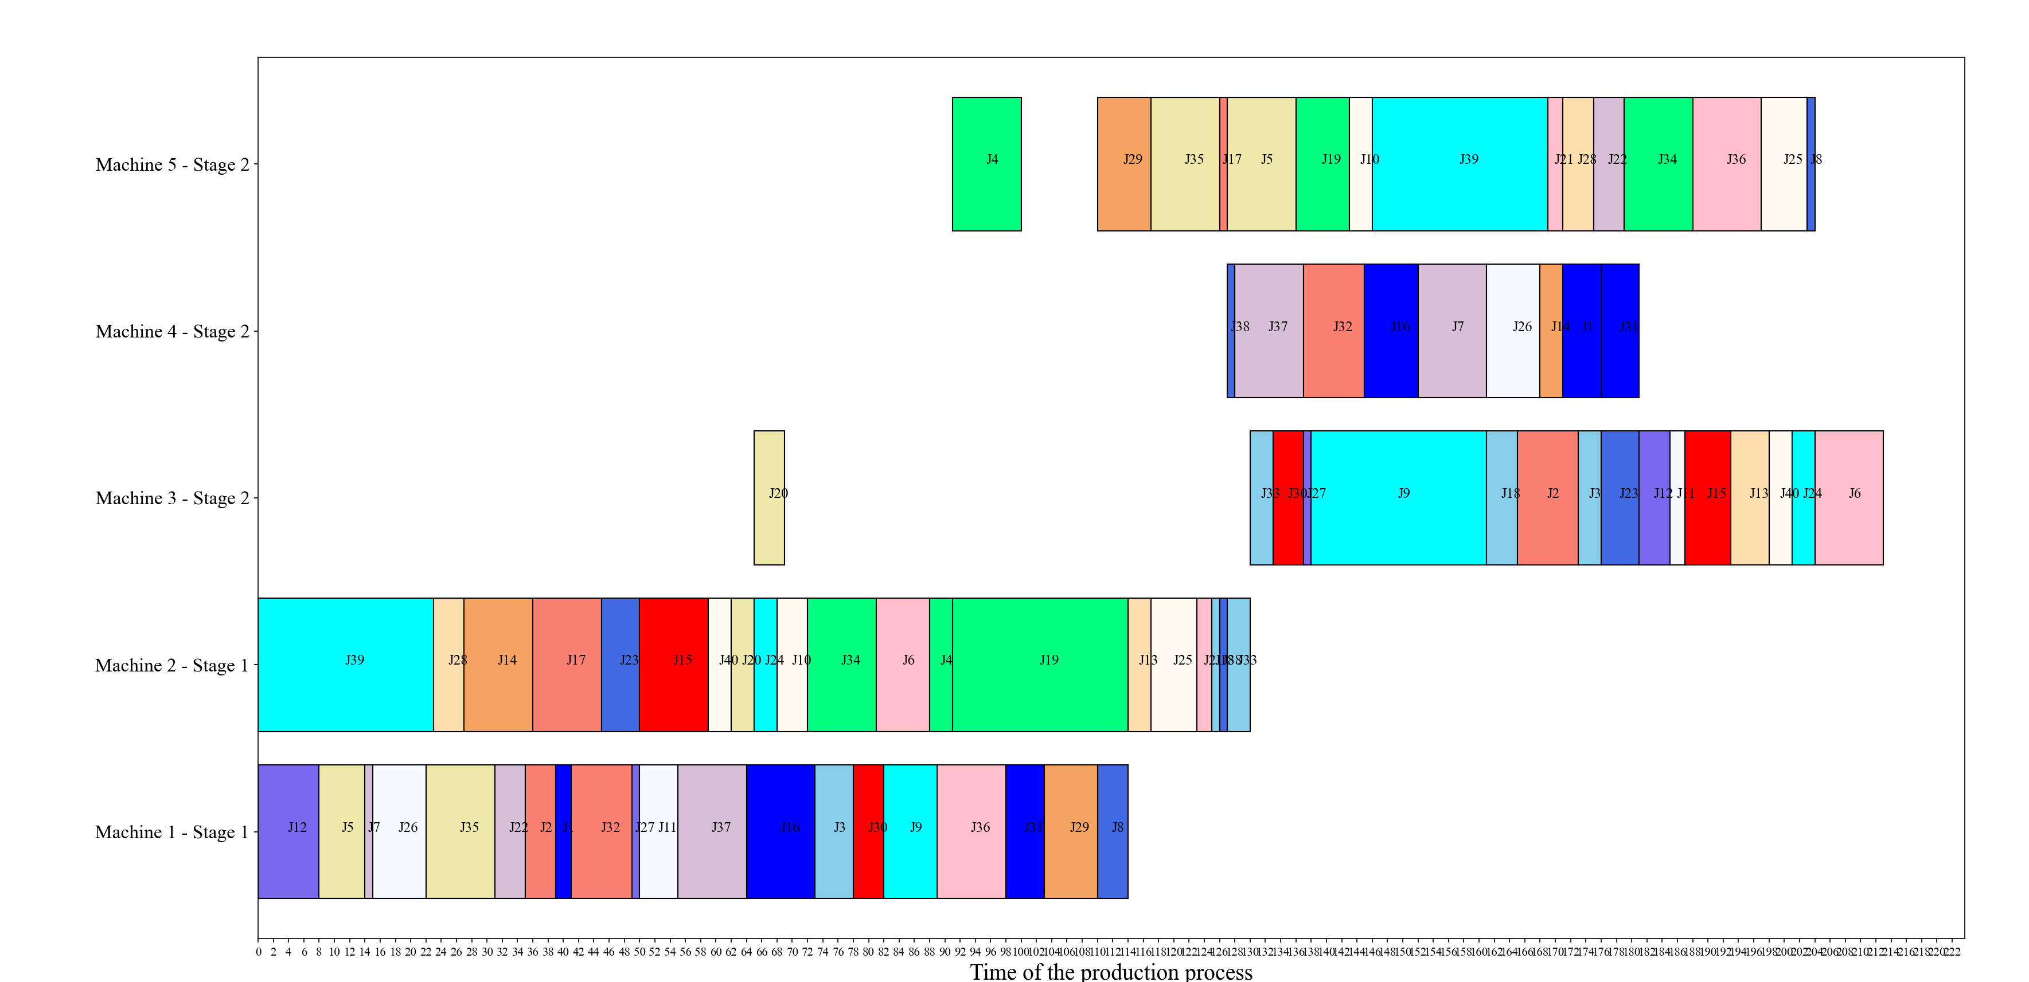
5. Case Study – Solution
Validation – Another algorithm that can deal with the larger problem
Gantt chart – the final schedule
Large-scale problem

